Slide 1

String Search 2: Boyer-Moore and Knuth-Morris-Pratt
By Arlen dumas and Max Johnson

Slide 2
Itinerary
What string searching is and when to use the right algorithm
Overview of Boyer-Moore
Overview of KMP (Knuth-Morris-Pratt)
Comparison between sorting algorithms
Live demo

Slide 3
What string searching is and when to use the right algorithm
String searching is simply looking for a word/pattern in a string.
But when is it better to use one over the other?
Notes:
What string searching is and when to use the right algorithm [[[enter]]] String searching is simply looking for a word/pattern in a string. Pressing control f on a webpage is a perfect example of that. Two good string search algorithms are BM and KMP. [[[enter]]] But when is it better to use one over the other? Well it will become clear as we go over the two algorithms, but the short of it is that BM is more equipped for long search patterns whereas KMP works better with patterns that contain sub-patterns.

Slide 4
Overview of Boyer-Moore

Slide 5
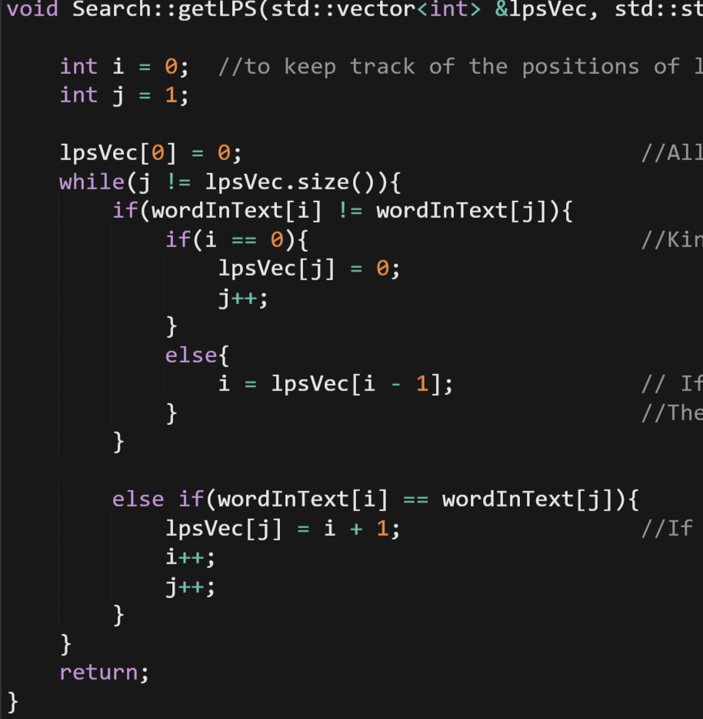
Overview of KMP
LPS (Longest proper Prefix).
0 1 2 3 4 5 6
bbxbbbx
I J
0 1
0
1
0
1
2
2
3
1 2
0 2
0 3
1 4
2 5
1 5
2 6
3 7
Notes:
A big portion of why KMP is so effective is because it finds sub patterns in the word being used.
[[[enter]]]
This is called LPS (Longest proper Prefix). The point of this is to not match any character that we know already matches. To get an in-depth example, we will use the word [[[enter]]]
bbxbbbx. Im sure you’ve heard of it. So following the code here. [[[enter]]]
We see that the first index is set to zero regardless.
[[[enter]]]
This is because there is nothing to compare it too yet. Now comparing character at index ‘i’ and ‘j’, we see that they do match. This means we set lpsVec at position j to ‘i’ + 1 and increment ‘I’ and ‘J’
[[[enter]]]
Looping, we see that ‘I’ and ‘j’ don’t match and since ‘I’ isn’t zero, we set ‘I’ to lpsVec[i-1].
[[[enter]]]
Looping again, ‘I’ is zero this time so we set lpsVec at position ‘j’ to 0 and increment ‘j’
[[[enter]]]
Looping again we see that ‘I’ and ‘j’ match so we set the next position to ‘I’ + 1 and increment ‘I’ and ‘j’
[[[enter]]]
Looping again, the same thing happens
[[[enter]]]
Looping again, ‘I’ and ‘j’ don’t match so ‘I’ is set to one position back in lpsVec
[[[enter]]]
Looping again, and this is important, you’ll notice that ‘I’ and ‘j’ match again. Which means we set the next position to 2 again. And of course, we increment
[[[enter]]]
Looping for the final time, ‘I’ and ‘j’ match so we set the next position to ‘I’ + 1 and increment.
[[[enter]]] <final>

Slide 6
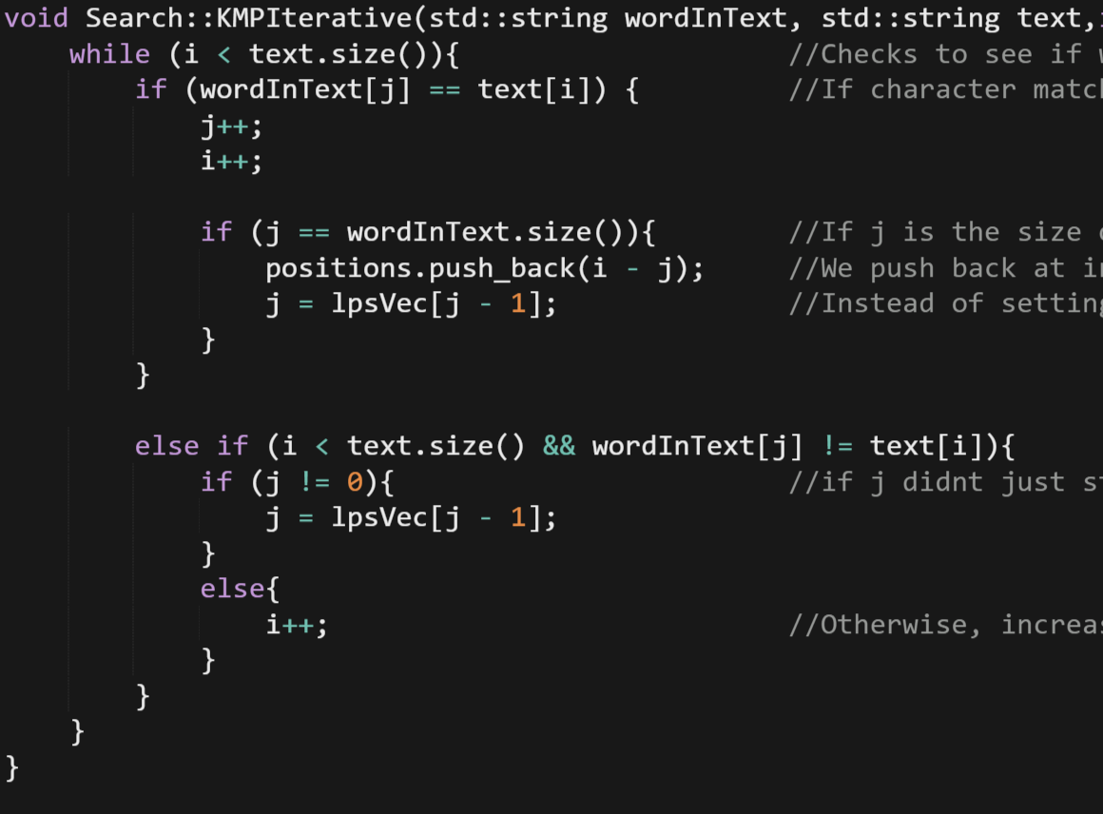
Overview of KMP Cont.
Notes:
So now that we have our LPS, which I consider the most important part, we now do the actual string searching. (while using lazer pointer) you got your pretty basic stuff. If characters match, increment ‘I’ and ‘j’ by one. If j managed to equal word size, it means the algorithm found a match so it adds the position to a vector labeled positions. Heres the important part though, instead of setting ‘j’ to 0, we set ‘j’ to lpsVec[j-1]. This allows us to save time by not checking the characters we don’t have to. If j hits zero he increment ‘I’ by one and loop again.

Slide 7
Comparison Between the Two

